Slide 1
IS113
Web Application Development I
Week 11
Sessions, Authentication and Authorization

Slide 2
Topics
Sessions
HTTP and states
Why use sessions
Session management in express (with express-sessions)
Authentication & Authorization
Authentication vs Authorization
Using Middleware for Authorization
Storing Passwords
Hashing passwords
Hashing in express (with bcrypt)
Security Best Practices
‹#›

Slide 3
HTTP and States
HTTP is a Stateless Protocol - HTTP server processes each request independently, without relying on previous interactions.
The server doesn’t remember any session state from earlier requests.
This means the client must include any necessary session information in every request it sends.
Using a stateless protocol like HTTP brings several benefits:
Visibility improves since monitoring tools can fully understand any request without needing context from earlier ones.
Reliability increases because recovering from failures is simpler when there's no stored session data to manage.
Scalability is enhanced as the server can release resources quickly after handling each request, making it easier to serve more clients efficiently.
‹#›

Slide 4
Why use Sessions?
Sessions maintain a state throughout multiple request response cycles
HTTP client
HTTP server
request 1 :login with username, password
Login successful
create a session
store username
return session-id
response 1 :set a cookie with session-id
HTTP is stateless
request 2 : with the session-id cookie
Find the session with session-id
check session validity
check session has a username set
response 2 :content for the matching user
‹#›

Slide 5
Sessions Management in Express
How it works:
The client receives a session ID stored as a cookie.
The server saves the actual session data linked to that session ID.
Express does not provide built-in support for sessions.
The express-session library is used to add session management to an Express application.
To install it, run: > npm install express-session.
To use it:
Attach it to the server as a middleware: sever.use({sessionOptions})
Specify the session options.
‹#›

Slide 6
Session options
secret (required) - Used to sign the session ID cookie, preventing tampering.
Use a long, random, unpredictable string.
Store it securely (e.g., in environment variables).
resave - Forces session to be saved back to the store on every request, even if it wasn’t modified.
The default value is true. It is usually recommended to set it to false to avoid unnecessary writes.
saveUninitialized - Saves new but unmodified sessions to the store.
The default value is true. Choosing false is useful for implementing login sessions, reducing server storage usage.
For complete list of available options refer to https://expressjs.com/en/resources/middleware/session.html
‹#›

Slide 7
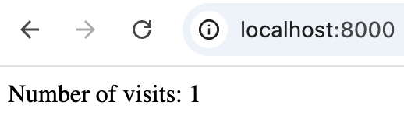
Page Visit Counter with Sessions (Example 1)
This example demonstrates a page counter implemented using sessions. It will store and display the number of times the page is visited.
From the provided resources folder, use the VS Code terminal to navigate to the example1 directory.
Update the SECRET variable in config.env file with your desired SECRET string. (to improve the security)
Install missing dependencies (if any) from package.json
> npm install
Enter the following command in the terminal to start the Express server:
> nodemon server.js
Next, open a browser (e.g., Chrome) and navigate to: http://localhost:8000/. The page will display output similar to the figure on the right.
Now refresh the page to increase the visit count.
‹#›

Slide 8
Page Visit Counter with Sessions (Example 1)
...
const session = require('express-session');
...
server.use(session({
secret: 'yourSecret',
resave: false,
saveUninitialized: false
}));
server.get('/', (req, res) => {
req.session.visit_count = req.session.visit_count + 1 || 1;
...
});
...
Import the express-session library
Initialize the session
Update the visit_count stored inside session. visit_count here is name of the variable we chose to store the number of page visits.
server.js
‹#›

Slide 9
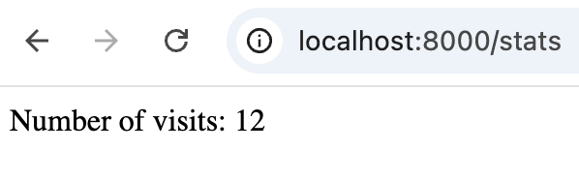
Add a Page Visit Counter to GET /stats (Exercise 1)
Exercise 1 - Implementing a Page Visit Counter
You have joined a development team working on a web-based application. One of the features of this app is to show the number of page visits. This will show users how many time that page being visited. The expected browser output (see Figure 1) is outlined below.
Expected Browser Output
Figure 1
‹#›

Slide 10
Add a Page Visit Counter to GET /stats (Exercise 1)
Exercise 1 - Implementing a Page Visit Counter
Review the requirements below and follow the task instructions step by step to complete the exercise.
Requirements:
Upon visiting the /stats, the application should display the number of page visits.
Each time the page is refreshed, the number should increase by 1.
Tasks:
Update the SECRET variable in config.env file with your desired SECRET string.
Install missing dependencies (if any) from package.json.
> npm install
Modify the provided server.js file to:
Import express-session library.
Initialize session using the SECRET from config.env.
Modify the provided stats function in users-controllers.js file to:
Initialize/increment the visit count and store it inside a session variable.
Show the number of visits in the webpage.
‹#›

Slide 11
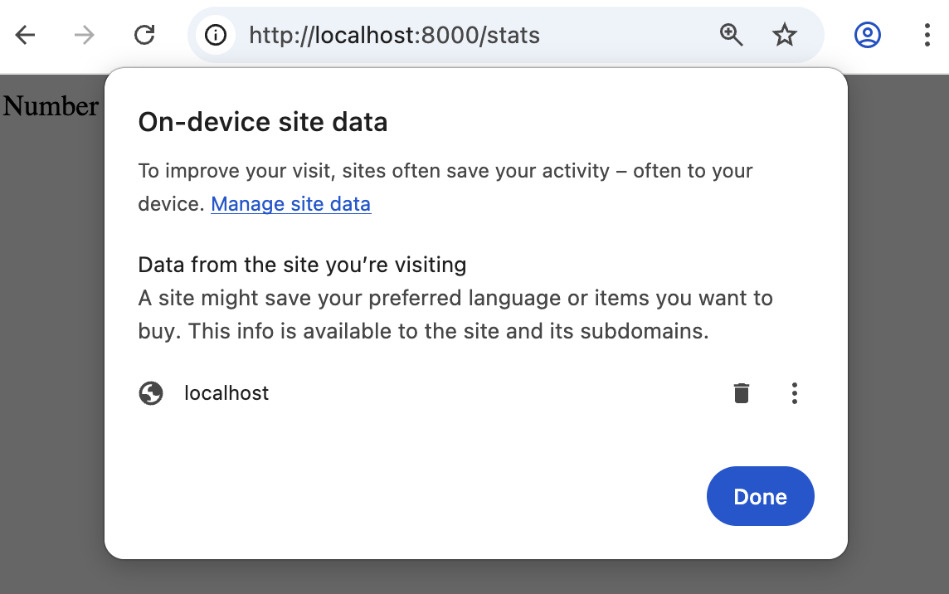
Disconnect the Session from Client Side (browser)
i -> Cookie and site data -> Manage on-device site data
This will delete the session cookies (among other things) stored in the browser
‹#›
Notes:
instructions on how to get here

Slide 12
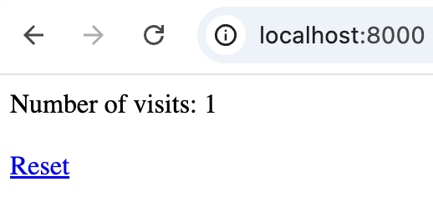
Destroy Session from Server Side (Example 2)
This example demonstrates how to delete a session from the code on the server side.
From the provided resources folder, use the VS Code terminal to navigate to the example2 directory.
Install missing dependencies (if any) from package.json.
> npm install
Enter the following command in the terminal to start the Express server:
> nodemon server.js
Next, open a browser (e.g., Chrome) and navigate to: http://localhost:8000/. The page will display output similar to the figure on the right.
Refresh the page to increase visit counter.
Click on reset to reset the page count.
‹#›

Slide 13
Destroy Session from Server Side (Example 2)
...
server.get('/reset', (req, res) => {
req.session.destroy(() => {
res.redirect('/');
});
});
...
Destroy the session (delete all the variables and data inside the session) and redirect to /
server.js
‹#›

Slide 14
Authentication vs Authorization
Aspect | Authentication | Authorization
Purpose | Verify who the user is | Determining what the user is allowed to do
Example | Login using username and password | Admin allowed to visit admin-profile page
Analogy | Showing ID card at building entrance | Access to specific restricted rooms
‹#›

Slide 15
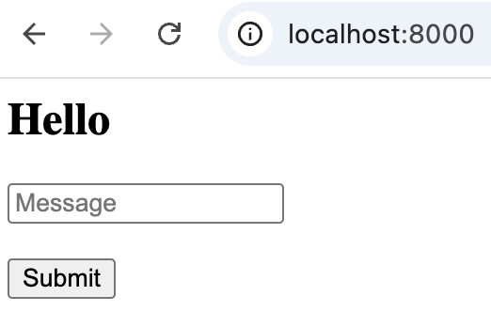
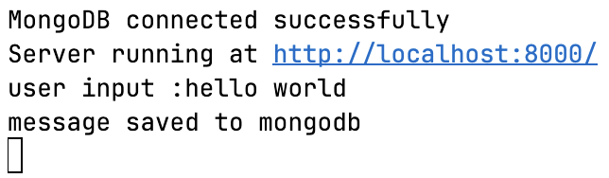
Retrieve Data from a Form and Save in MongoDB (RECAP, Example 3)
This example is to remind you how to use forms and MongoDB.
From the provided resources folder, use the VS Code terminal to navigate to the example3 directory.
Update the DB variable in config.env file with your MongoDB String.
Install missing dependencies (if any) from package.json.
> npm install
Enter the following command in the terminal to start the Express server:
> nodemon server.js
Next, open a browser (e.g., Chrome) and navigate to: http://localhost:8000/.
Enter a text to the text box and click on submit.
You should see an output similar to Figure 2 on the terminal.
Figure 1
Figure 2
‹#›

Slide 16
Retrieve Data from a Form and Save in MongoDB (RECAP, Example 3)
<form action="/" method="POST">
...
<input name="message" placeholder="Message" required > <br><br>
...
Input field to get a text input from user
home.ejs
...
console.log('user input :' + req.body.message);
try {
const message = {
message: req.body.message,
};
await Message.addMessage(message);
console.log('message saved to mongodb');
...
Print the user input to the console
Save the user input to the MongoDB
messages-controller.ejs
‹#›

Slide 17
Revisiting Sessions
Sessions can be used to keep the user logged in state throughout multiple request response cycles.
HTTP client
HTTP server
request 1 :login with username, password
Login successful
create a session
store username
return session-id
response 1 :set a cookie with session-id
HTTP is stateless
request 2 : with the session-id cookie
Find the session with session-id
check session validity
check session has a username set
response 2 :content for the matching user
‹#›

Slide 18
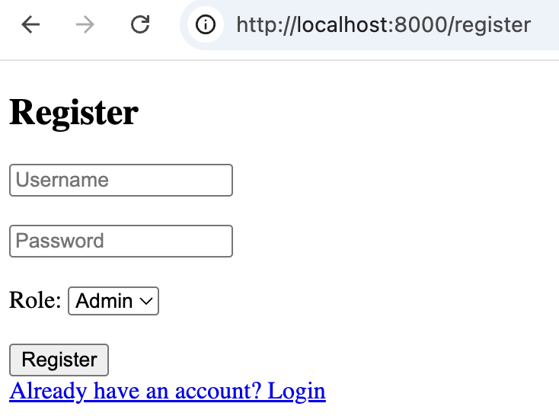
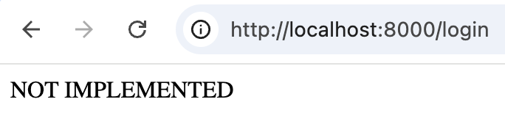
Implement User Registration (Exercise 2)
Exercise 2 - Implementing User Registration
In this exercise you’ll add the user registration feature to the website. If the registration is successful user should get redirected to login page. Otherwise user should get redirected back to registration page.
Expected Browser Output
failure
success
‹#›

Slide 19
Implement User Registration (Exercise 2)
Exercise 2 - Implementing User Registration
Review the requirements below and follow the task instructions step by step to complete the exercise.
Requirements:
Upon visiting the /register, the application should display a form to input the registration details.
After a successful registration user should get redirected to the /login.
After a unsuccessful registration user should get redirected back to the /register
‹#›

Slide 20
Implement User Registration (Exercise 2)
Exercise 2 - Implementing User Registration
Tasks:
Start with your solution to the exercise 1.
Update the DB variable in config.env file with your MongoDB String.
Install missing dependencies (if any) from package.json.
> npm install
In the provided user-controllers.js file to:
Modify the registerGet to render the register.ejs.
Modify the registerPost to,
Create a new User object.
Save the user to MongoDB.
If above steps are successful, redirect the user to /login.
If above steps are unsuccessful, redirect the user to /register.
‹#›

Slide 21
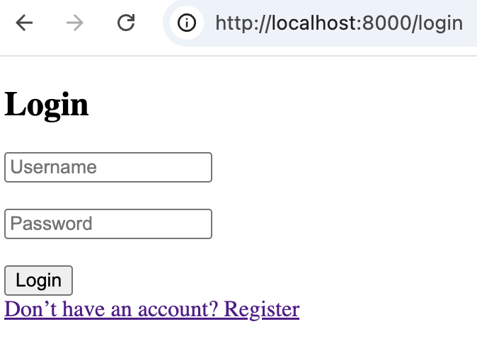
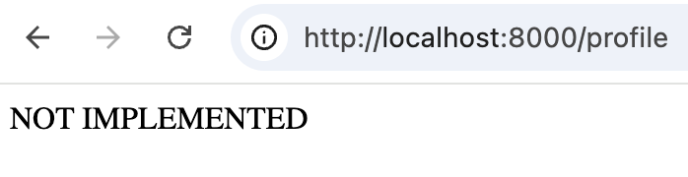
Implement User Login - Authentication (Exercise 3)
Exercise 3 - Implementing User Login
In this exercise you’ll add the user login feature to the website. If the login is successful user should get redirected to profile page. Otherwise user should get redirected back to login page.
Expected Browser Output
failure
success
‹#›

Slide 22
Implement User Login - Authentication (Exercise 3)
Exercise 3 - Implementing User Login
Review the requirements below and follow the task instructions step by step to complete the exercise.
Requirements:
Upon visiting the /login, the application should display a form to input the login details.
After a successful login user should get redirected to the /profile.
After a unsuccessful login user should get redirected back to the /login.
‹#›

Slide 23
Implement User Login - Authentication (Exercise 3)
Exercise 3 - Implementing User Login
Tasks:
Start with your solution to the exercise 2.
Add an line to the config.env file with your DB string.
Install missing dependencies (if any) from package.json.
> npm install
In the provided user-controllers.js file to:
Modify the loginGet to render the login.ejs
Modify the loginPost to,
Get the User object (from the database) matching the submitted username.
If not found, redirect user back to /login.
If found, compare the entered password with the stored one.
If they don't match, redirect back to /login.
If they match, store the user's id, username & role in the session, then redirect to /profile.
If an error occurred, during any of the above operations, log the error and redirect user to /login.
‹#›

Slide 24
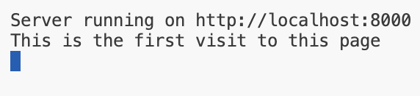
Check for Objects in Session (Example 4)
This example demonstrates how to check for objects stored in the session. We’ll use this for implementing authorization features later.
From the provided resources folder, use the VS Code terminal to navigate to the example4 directory.
Install missing dependencies (if any) from package.json.
> npm install
Enter the following command in the terminal to start the Express server:
> nodemon server.js
Next, open a browser (e.g., Chrome) and navigate to: http://localhost:8000/. The page will display output similar to the Figure 1. And terminal will display output similar to the Figure 2.
Figure 1
Figure 2
‹#›

Slide 25
Check for Objects in Session (Example 4)
...
server.get('/', (req, res) => {
if (!req.session.visit_count) {
console.log("This is the first visit to this page");
...
});
...
Check for the objects in the session
server.js
‹#›

Slide 26
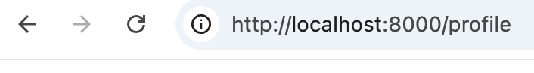
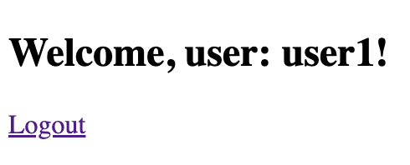
Protect Access to User Profile - Authorization (Exercise 4)
Exercise 4 - Protect the Access to User Profile
In this exercise you’ll allow the access to profile page only for logged in users .
Expected Browser Output
user is not logged in
User is logged in
‹#›

Slide 27
Protect Access to User Profile - Authorization (Exercise 4)
Exercise 4 - Protect the Access to User Profile
Review the requirements below and follow the task instructions step by step to complete the exercise.
Requirements:
Upon visiting the /profile, the application should display profile details only to the logged in users.
For the user is not logged in, it should redirect them to the login page.
Tasks:
Start with your solution to the exercise 3.
Install missing dependencies (if any) from package.json.
> npm install
In the provided user-controllers.js file to:
Modify the profile to check for a user object in the session.
If a user object does not exist in the session, redirect the user to /login page.
If a user object exists in the session, render the profile.ejs template.
‹#›

Slide 28
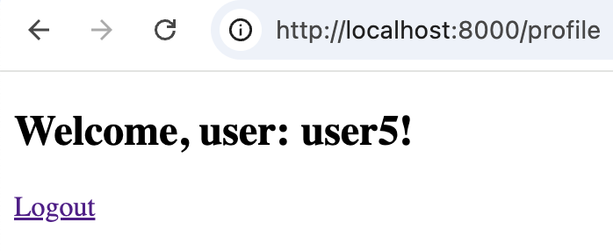
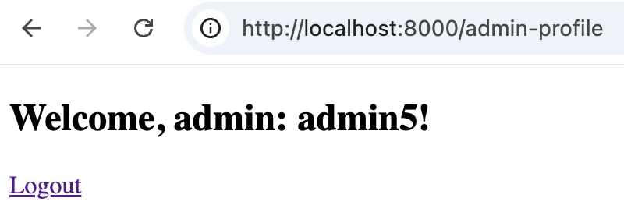
Direct Admin Users to Admin Profile Page - Authorization (Exercise 5)
Exercise 5 - Direct Admin Users to Admin Profile Page
In this exercise you’ll direct the admin users to admin profile page.
Expected Browser Output
regular user
admin user
‹#›

Slide 29
Direct Admin Users to Admin Profile Page - Authorization (Exercise 5)
Exercise 5 - Direct Admin Users to Admin Profile Page
Review the requirements below and follow the task instructions step by step to complete the exercise.
Requirements:
Upon login to the website,
Regular users need to be redirected to profile page.
Admin users need to be redirected to admin page.
Tasks:
Start with your solution to the exercise 4.
Install missing dependencies (if any) from package.json.
> npm install
In the provided user-controllers.js file to:
Modify the loginPost to check the user role and redirect accordingly.
Modify the adminProfile to,
If there’s no user in the session redirect to /login.
If the user is in the session and role is not admin, redirect to /profile.
If the user is in the session and role is admin, render admin-profile.ejs.
‹#›

Slide 30
Using Middleware for Authorization
What is Middleware?
Middlewares are functions that run during the request-response cycle in Express.
They can modify req and res, execute logic, or stop the request.
Why Use Middleware for Authorization?
Enables re-using the code.
Keeps routes/controllers clean.
Centralized access control logic.
Example Use Case
Check if user is authenticated.
Verify user role (e.g., Admin, Instructor).
Router function
Middleware function
receive a web request
Call the middleware function
Execute middleware code
Call next() to pass the control back
Return back to the router
continue with router code
‹#›

Slide 31
Using Middleware for Authorization (Example 5)
This example demonstrates how to use middleware to protect the routes
From the provided resources folder, use the VS Code terminal to navigate to the example5 directory
Install missing dependencies (if any) from package.json
> npm install
Enter the following command in the terminal to start the Express server.
> nodemon server.js
Next, open a browser (e.g., Chrome) and navigate to: http://localhost:8000/
The web application will behave as same as exercise 5 solution
‹#›

Slide 32
Using Middleware for Authorization (Example 5)
exports.profile = (req, res) => {
res.render('profile', { user: req.session.user });
}
exports.adminProfile = (req, res) => {
res.render('admin-profile', { user: req.session.user });
}
Controllers are cleared up from authorization logic
users-controller.js
router.get('/profile',authMiddleware.isLoggedIn, usersController.profile);
router.get('/admin-profile',authMiddleware.isAdmin, usersController.adminProfile);
Routes calling the middleware functions
user-routes.js
‹#›

Slide 33
Using Middleware for Authorization (Example 5)
exports.isLoggedIn = (req, res, next) => {
if (!req.session.user) {
console.log("User not logged in, redirecting to /login");
return res.redirect('/login');
}
next();
}
...
Authorization code
Call the next middleware function in the stack
auth-middleware.js
‹#›

Slide 34
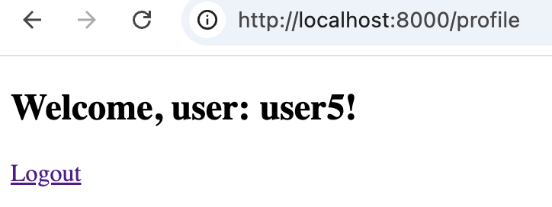
Implement Logout Feature (Exercise 6)
Exercise 6 - Implement Logout feature
In this exercise you’ll implement the logout feature.
Expected Browser Output
logout
‹#›

Slide 35
Implement Logout Feature (Exercise 6)
Exercise 6 - Implement Logout Feature
Review the requirements below and follow the task instructions step by step to complete the exercise.
Requirements:
Upon clicking logout from the profile page,
Logout the user.
Redirect users to login page.
Tasks:
Start with your solution to the exercise 5.
Install missing dependencies (if any) from package.json.
> npm install
In the provided user-controllers.js file,
Modify the logout function to destroy the session, and redirect the user to /login.
‹#›

Slide 36
Hashing Passwords
Why Storing Passwords in Plain Text Needs to be Avoided:
Storing passwords in plain text exposes them to anyone who gains unauthorized access to the passwords.
In case of a data breach, attackers can easily retrieve and misuse all user passwords.
Solution: Hashing Passwords
Hashing is a process that turns input data (like passwords) into an irreversible, fixed-length string, known as a hash. making them unreadable even if the database is compromised.
Use strong, modern hashing algorithms (e.g., bcrypt, Argon2) for enhanced security.
More About Hashing:
One-way process: Once data is hashed, it can't be turned back into the original input.
Deterministic: The same input will always result in the same hash.
Fast and Secure: Hashing algorithms are quick to compute (but some, like bcrypt, add delays to make brute-force attacks harder)
‹#›

Slide 37
Hashing in Express
We will use bcrypt algorithm to hash our passwords.
bcrypt is modern and considered a strong hashing algorithm.
To install bcrypt, > npm install bcrypt
‹#›

Slide 38
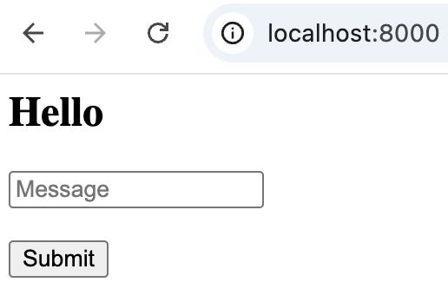
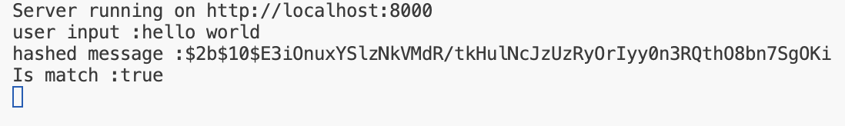
Hashing and Comparing the Hash (Example 6)
This example demonstrates how to work with hashed passwords.
From the provided resources folder, use the VS Code terminal to navigate to the example6 directory.
Install missing dependencies (if any) from package.json
> npm install
Enter the following command in the terminal to start the Express server.
> nodemon server.js
Next, open a browser (e.g., Chrome) and navigate to: http://localhost:8000/. The page will display output similar to the Figure 1.
Next, enter a text in to the input field and click submit
Terminal will display output similar to Figure 2.
Figure 1
Figure 2
‹#›

Slide 39
Hashing and Comparing the Hash (Example 6)
server.post('/', async (req, res) => {
const originalMessage = req.body.message;
console.log('user input :' + originalMessage);
const hashedMessage = await bcrypt.hash(originalMessage, 10);
console.log('hashed message :' + hashedMessage);
const match = await bcrypt.compare(originalMessage, hashedMessage);
console.log('Is match :' + match);
...
Hash the text
Compare the hashed text with original text
server.js
‹#›

Slide 40
Hash the User Passwords (Exercise 7)
Exercise 7 - Hash the User Passwords
In this exercise you’ll change the web application to work with hashed passwords. This won’t add any new features to the application. But after this your application will be more secure.
Requirements:
Make the website work with hashed passwords (instead of plain text passwords).
Tasks:
Start with your solution to the exercise 6.
Install missing dependencies (if any) from package.json.
> npm install
In the provided user-controllers.js file,
import the bcrypt library
Modify the registerPost function to hash the plain text password and store the hashed password in MongoDB.
Modify the loginPost function to compare the user entered password with hashed password from MongoDB.
NOTE: Once you made this change, the existing users won’t be able to login to the website.
‹#›

Slide 41
Security Best Practices
Use a strong secret when creating session.
And consider rotating secrets periodically.
Storing the sensitive information separate from the code (config.env file).
Session secret.
MongoDB connection string.
Never store the passwords in plain text format.
Use native tools when available (over third party packages).
Make sure the files with sensitive information not published.
Use .gitignore to prevent the config.env managed by git.
Always verify .gitignore to correctly excludes sensitive files.
In production run the web-server in HTTPS mode.
Redirect all HTTP traffic to HTTPS.
Regularly update your TLS configuration and renew certificates.
‹#›

Slide 42



Why Best Practices
‹#›
Notes:
https://www.csoonline.com/article/3488207/aws-environments-compromised-through-exposed-env-files.html
https://en.wikipedia.org/wiki/2021_Epik_data_breach
https://hackernoon.com/scanning-26-million-domains-for-exposed-env-files
https://www.theverge.com/2019/3/21/18275837/facebook-plain-text-password-storage-hundreds-millions-users

Slide 43
What Have We Learned?
HTTP’s stateless nature and how sessions solve this.
Authentication and authorization.
User registration, login and logout flow.
Password hashing with bcrypt.
Best practices for securing web applications.
‹#›

Slide 44
